Slide 1
Muslim Rule in India 712-1857

Slide 2
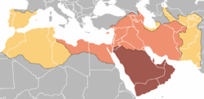
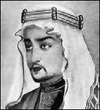
Muhammad bin Qasim Al-Thaqafi (31 December 695–18 July 715)
Umayyad General
Iraq Governor, Hijaj bin Yousaf
Married his Daughter
Foundation of Islamic Rule in Subcontinent

Slide 3
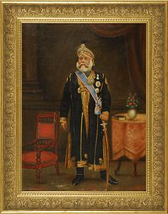
Causes of Sindh Invasion
Attacked by Raja Dahir’s forces on Muslim’s ship
The Arab were imprisoned later on by the Debal Governor.
Refusal of Raja Dahir
Hajjaj sent Muhammad Bin Qasim for
this expedition in 711 A.D.

Slide 4
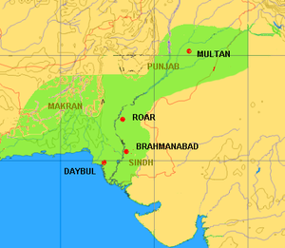
Campaign
Third Expedition
Makran Arman Belah(lasbela) Debal (Karachi) Sadusan (Sehwan), Nerunkot (Hyd), Brahamnabad (Shehdad Pur)
Ar-rur (Rohri,Nawabshah) met by Dahir's forces
Captured (Multan)

Slide 5
Reason for Success
Superior military equipment
Troop discipline and leadership.^{[4]}
The concept of Jihad as a morale booster.^{[4]}
Religion; the widespread belief in the prophecy of Muslim success.^{[4][12]}
The ‘Samanis” the majority of the population was Buddhist who were dissatisfied with their rulers, who were Hindu.^{[12]}

Slide 6
Death
Revolt in Umayyad
Death of Hijaj bin Yousaf
M.Bin Qasim Returned
Murdered on way

Slide 7
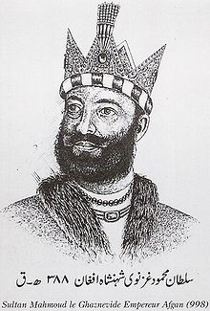
Sultan Mehmood Ghaznavi (November 2, 971 - April 30, 1030)
Son of Sabuktagin
Ruled from 997 to 1030
Dynasty (Afghanistan, Eastern Iran, Pakistan, North Eest India)
17 expeditions on India

Slide 8
Campaign
Started from (Khorsan, Balkh, Herat, Merv) Afghanistan, from Samanids in 999
Seistan (Iran) 1000
Ghandhara (Peshawar) defeats Jaypal 1001
Multan, Ismail shah & Anandapala
Expeditions in India against Rajput
(Ujjain, Gwalior, Kalinjar, Kannauj,iAjmer, Kangra. HP) 1008

Slide 9
Takes Lahore on his return
Nehrwala, Kathiawar, Somnath This raid was his last major campaign.
Somnath 1025: killing over 50,000 people who tried to defend it
Sultan Mahmud died on April 30, 1030 at Ghazni

Slide 10
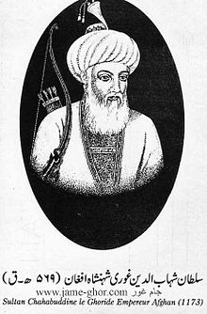
Sultan Muhammad Shahabu-ddin Ghori (1150 – 15 March 1206)
Mu'izzuddīn Muḥammad Bin Sām
Born in Ghor, Afghanistan
Brother Ghayassu-ddin
Ghorid’s Dynasty (Afghanistan, Pakistan, North East India)

Slide 11
Campaign
Multan & Uch 1175
Attacked Gujrat 1178, defeated by Rajput Bhimdev Solanki II
Capture Lahore 1181
Conquered Sialkot 1181
Attacked Terrain (Delhi) against Prithvi Raj Chohan (Rajput) 1191, Loss
Attacked Terrain 1192 again, become Victorious

Slide 12
Moved to Ajmer + North Rajasthan
Attacked Ayodhya temple, capture Delhi 1193
Made Qutbuddin Aibak his Deputy of Sultanate
Conquered Bengal 1204
Murdered by Hindu warrior near Jhelum 1206

Slide 13
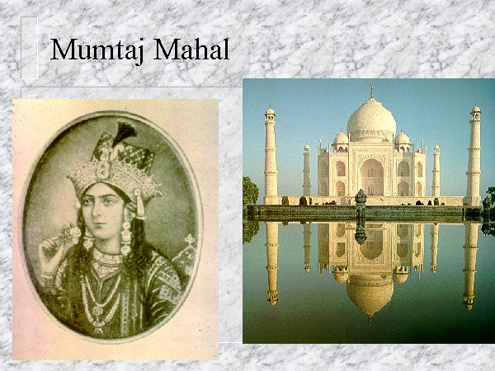
The Great Mughal Empire
1526-1707

Slide 14
The Mughals were descendants of two great rulers. From their mother’s side they were descendants of Genghis Khan, ruler of the Mongol tribes, China & Central Asia. From their father’s side they were the successors of Timur, the ruler of Iran, Iraq & Modern-day Turkey.

Slide 15
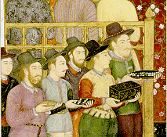
Mughal Empire
Under the Mughals, India was the heart of a great Islamic empire and a prolific center of Islamic culture and learning.
Dynasty was the greatest, richest and longest lasting Muslim dynasty to rule India.
Mongol Descendents
The Great Mughal Emperors were:
  Babur (1526-1530) The First of the Mughals
  Humayun (1530-1556) The Luckless Leader
  Akbar (1556-1605) The Great
  Jehangir (1605-1627) The Paragon of Stability
  Shah Jehan (1627-1658) The Master Builder
  Aurangzeb (1658-1707) The Intolerant

Slide 16
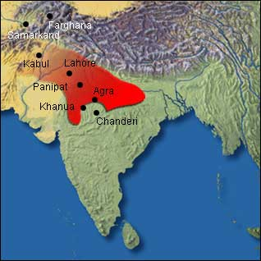

Babur 1526 - 1530
The First of the Mughals
Born on 14 Feb 1483 Uzbekistan
Babur was a direct descendant of the Turkish Ghengis Khan and Timur from Tamerlane.
Defeated the Delhi Sultanate (Ibrahim Lodhi at Panipat 1526 & Rana Sanga rajput 1527 ) & established the Mughal Empire.
Gained control of the whole northern India
  Made Agra capital
He reigned for 4 short years and died at age 47 in 1530.
Did not enact new laws or organization in the empire due to early his death
Buried in Kabul

Slide 17

Humayun 1530 - 1556
After Babur died, he was succeeded by his son Humayun in 1530. Humayun was 23 years old.
He was not a soldier and unlike his father, neither skilled nor a wise leader.
Inherited a disunited and disorganized empire.
In 1540, Sher Shah Suri defeated Humayun and took over the Mughal Empire. The Empire was lost from 1540-1545.
  He was exiled but later regained power in 1555.
  Humayun died in 1556 after falling down the steps of his library.

Slide 18

Akbar 1556 - 1605
The Great
Akbar become the new Mughal ruler at the age of 14.
Akbar was an ambitious and noble commander
  Built the largest army ever in the empire.
  Helped to conquer nearly all of modern-day northern India and Pakistan.
Great administrator
  developed a centralized government
    It delegated 15 provinces each under a governor and each province into districts and each district was further sub-divided into smaller sections.
Best known for tolerance of his subjects (especially Hindus)
Invited religious scholars to debate him in his private chambers.
  Developed his own faith call Din Ilahi.
    Din Ilahi was a mixture of the other religions Akbar had studied from those debates.
    Died and Buried at Sikandra (agra)

Slide 19

Jehangir 1605 - 1627
The Paragon of Stability
Jehangir (Prince Salim) succeeded his father Akbar in 1605.
He continued many of Akbar’s policies.
  Freedom of worship.
  Fair treatment of Hindus.
  Continued friendship and alliance with Rajputs.
  Allowed foreigners like the Portuguese and English into India for trade.
Jehangir married Nur Jahan. She became the real ruler of the empire until the death of her husband.

Slide 20
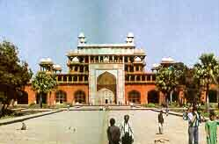
Jehangir Issues (specific)
Under the influence of his wife and many others, Jehangir was not an able ruler like his father.
  He loved to drink and enjoy himself.
  He had to suppress many rebellions.
  Important posts in the court were given to families, friends, and especially those close to his wife, Jahan.

Slide 21

Shah Jehan 1627 - 1658
The Master Builder
Shah Jehan (Prince Khurram) succeeded his father in 1627.
Better ruler than Jehangir.
  Restored the efficiency of government.
  Recovered territories.
  Maintained peace
  Foreign traders were allowed into India and trade increased considerably.
The empire was expanded.
Shah Jehan was a patron of the arts
  Built many great architecture buildings including the Taj Mahal

Slide 22
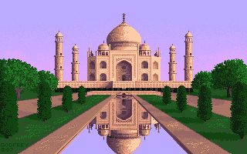
Shah Jehan
Taj Mahal (Mumtaz)
  Built in honor of his wife (Arjuman Bano)
1657 - Shah Jehan became seriously ill and a dispute over the succession of the throne between his three sons.
Aurangzeb deposed Shah Jehan in 1658. Shah Jehan was imprisoned in the Octagonal Tower of the Agra Fort from which he could see the Taj Mahal. He died in 1666 and was buried next to his wife in the Taj Mahal.

Slide 23

Aurangzeb 1658 - 1707
The Intolerant
Aurangzeb ascended the throne after disposing his father and beating out his two brothers.
Dictator
  severely mistreated Hindus of Northern India.
Empire declines under his reign
  He removed the tax-free status (Jizya)for Hindus
  Crushed semi-autonomous Hindu states
Primary Interest - Promote Islam

Slide 24
Aurangzeb
Aurangzeb over expanded the empire and strained his resources.
  Large sums of money and manpower were lost.
  He lost the support of the Hindu people.
  The over expansion of his empire weakened his administration.
Aurangzeb died in 1707
Son Bahadur Shah I succeeded him., he only managed to live a few more years. But at this point in time, the government was so unstable and so weak, the empire become an easy target of invasion and exploitation, first by the Persians, and then by the British.
The death of Aurangzeb, the empire started its gradual decline.

Slide 25
Summary: The Dynasty of the Great Mughals in India
1526-1530 Babur’s victory at Panipat in 1526 established the Mughal Empire and ended the reign of the Delhi Sultanate. The rise of the great Mughal Dynasty in India began with Babur.
1530-1556 Humayun succeeded his father Babur and became emperor. He was defeated and dislodged by insurrections of nobles from the old Lodi regime. In 1540, the Mughal domain came under control of Farid Khan Sur (Shir Shah Sur). Humayun died at the age of 48 when he fell down the steps of his library.
1556-1605 Akbar, the most sophisticated Mughal commander and leader, was only 14 years of age when he succeeded his father Humayun. Under Akbar's reign, Muslims and Hindu’s received the same respect.

Slide 26
Summary: The Dynasty of the Great Mughals in India
1605-1628 Jehangir succeeded his father, Akbar.
1628-1658 Prince Khurram was 35 years old when he ascended the throne as Shah Jehan, conqueror of the World.
1659-1707 In the summer of 1659, Aurangzeb held a coronation in the Red Fort where he assumed the title of Alamgir (World Conqueror). After a bitter struggle with his two brothers, Aurangzeb was the victor who took the throne.
1857 Bahadur Shah II, the last Mughal emperor, was deposed in 1858. India was brought under the direct rule of the British Crown. This brought the end of the Mughal Empire.

Slide 27
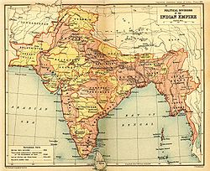
British Rule in India

Slide 28
British Rule
East India Company 1601
Trade (Cotton, Silk, Salt, Tea)
Surat, Madras, Bombay Calcutta… Trading zone
Well Established in 1690
Battle of Palessy 1757 was the major offense by Company against Nawab Sirajudullah of Bengal
Captured Bombay from Marathas
Conquered Mysore by defeating Tipu Sultan, Battle of Seringapatam 1799.

Slide 29
WAR OF INDEPENDENCE 1857

